Slide 1

八省续写
Continuation Writing
Notes:
更多精美模板请访问卡卡办公网：https://www.kakappt.com

Slide 2
was fed up with people’s coldness/indifference
cynical（愤世嫉俗的）
During this past year, I've had three instances of car trouble. Each time these things happened, I was sick of the way most people hadn't bothered to help. One of those times, I was on the side of the road for close to three hours with my big Jeep. I put signs in the windows, big signs that said NEED A JACK（千斤顶）, and offered money. Nothing. Right as I was about to give up, a Mexican family in a small truck pulled over, and the father bounded out.
disappointed
hopeful
Plot 1: Stuck on the road due to car trouble, I came across a Mexican family, who stopped to check on me.

Slide 3
He sized up the situation and called for his daughter, who spoke English. He conveyed through her that he had a jack but that it was too small for the Jeep, so we would need something to support it. Then he got a saw（锯子）from the truck and cut a section out of a big log on the side of the road. We rolled it over and put his jack on top, and we were in business.
I started taking the wheel off, and then, if you can believe it, I broke his tire iron(撬车胎棒). No worries: He handed it to his wife, and she was gone in a flash down the road to buy a new tire iron. She was back in 15 minutes. We finished the job, and I was a very happy man.
concerned
helpful,
generous
happy
Plot 2: The father helped me fix my car.

Slide 4
generous
grateful
The two of us were dirty and sweaty. His wife prepared a pot of water for us to wash our hands. I tried to put a $20 bill in the man's hand, but he wouldn't take it, so instead I went up to the truck and gave it to his wife as quietly as I could. I asked the little girl where they lived. Mexico, she said. They were in Oregon so Mommy and Daddy could work on a fruit farm for the next few weeks. Then they would go home.
Plot 3: Despite the father’s refusal, I insisted on paying this family 20 dollars, so I quietly left the money with the wife.

Slide 5
Read the plot
Clarify the main events (理清主要事件)
The girl asked me if I’d had lunch.
climax
I gave the money to the wife and talked to the girl.
Relieved
rising action
falling action
The family wouldn’t accept my 20 dollars.
What happened?
Emotions?
A Mexican family helped me fix car.
Grateful/Happy
My car broke down.
Cynical
ending
plot
emotions
beginning

Slide 6
每个段落，想3个主要片段，先内容，后语言
内容：1）从第二段首句到结局：想3个主要片段
2）从故事到第二段首句：想三个主要片段，盯着第二段首句编
特别要关注问题的解决过程和三个过渡句；注意时空变化及人物情感变化；切不可偏离文章主题，不要想太复杂，别给自己挖坑

Slide 7
Read the given sentences
Predict the ending (预测故事结尾)
Para.1 When I was about to say goodbye, the girl asked if I'd had lunch.
Para.2 After they left, I got into my Jeep and opened the paper bag.
A dilemma/
hesitation
Q1: What was my reacton? (about lunch) （Why did she ask me the question?)
Q2: What did the girl (and the family)do then? (The paper bag)
Q3: What's my reaction?
Q4:How did they leave?How did we bid farewell?
Q1: What did I find in the paper bag?
Q2: What's my response?
Q3: How did I change the opinion towards strangers? What does the story intend to tell readers?
A delight

Slide 8
list the writing points
List the outline (罗列写作要点)
Para.1
plot | emotions
Para.2
plot | emotions
I responded to the girl.
The girl handed me the lunch.
The Mexican family left.
hesitant/
embarrassed/awkward
I found lunch and something else in the paper bag.
my reflections on the event
surprised
/moved
moved/
grateful
delighted

Slide 9
Para 1： When I was about to say goodbye, the girl asked if I'd had lunch.
1 我不好意思再蹭他们的午饭
(接受？拒绝？我骗她说吃了; 肚子饿，叫 了，只能承认没吃饭）
2.拿吃的给我
（女孩去拿吃的给我；母亲？）
3我的反应和告别
（叮嘱/祝福/交换联系方式...)
Para 2：After they left, I got into my Jeep and opened the paper bag.

Slide 10
片段一
我骗她说吃了
However, with hesitation in my mind, thinking about the trouble I had brought to the family, I told her I had.
肚子饿，叫了承认没吃饭。
Suddenly, my rumbling stomach betraying me, I had no choice but to admit I was starving, with an awkward smile on my face.

Slide 11
片段二
女孩去拿吃的给我
Winking her eyes, she put her hands over her mouth and smiled. Asking me to wait for a while,she went back to her family, searching around their car, heading back towards me, with a bottle of water, a chicken roll as well as some fruit held in her hands. At that moment, the girl failing to hold so many items, her mother provided her with a small paper bag, talking to her in whispers.

Slide 12
片段三
告别
Then, with joy and excitement full of her heart, she ran to me, handing me the samll paper bag.When I took over the bag, she waved me good bye and wished me good luck.
Para 2：After they left, I got into my Jeep and opened the paper bag.
1.打开纸袋发现里面有吃吃喝喝；有20刀和一张纸条
2.我热泪盈眶，感动，感激
3. 人生感悟(解决问题）

Slide 13
片段1
打开纸袋，发现里面有吃吃喝喝。
Obviously, the bag was filled with food and drinks.
有20刀和一张纸条
To my surprise, the $20 bill, which was enough to cover a budge of one month, came into sight, along with a note attached, reading “ rose presented, smell remained”.
片段二
我热泪盈眶，很感动，很感激
In an instant, with tears of rolling in my eyes, I was more than moved. They would never know what they did for me meant far more than they could imagine.

Slide 14
片段3
想起他们花时间和精力帮陌生人
On the rest of my journey, the valuable experience haunting, I kept thinking about how kind and enthusiastic they were to help a stranger.
人生感悟
I felt a strong sense of mission, for a Mexican family, total stangers，gave me a hand in time, rebuilding my faith in people and encouraging me to pass on the act of kindness to others, which, indeed, was undoubtedly not only profound but also exciting.

Slide 15
When I was about to say goodbye, the girl asked if I'd had lunch. However, with hesitation in my mind, thinking about the trouble I had brought to the family, I told her I had, feeling appreciated but actually hungry at the same time. Suddenly, my rumbling stomach betraying me, I had no choice but to admit I was starving, with an awkward smile on my face. Winking her eyes, she put her hands over her mouth and smiled. Asking me to wait for a while, she went back to her family, searching around their car, heading back towards me, with a bottle of water, a chicken roll as well as some fruit held in her hands. At that moment, the girl failing to hold so many items, her mother provided her with a small paper bag, talking to her in whispers. Then, with joy and excitement full of her heart, she ran to me, handing me the samll paper bag.When I took over the bag, she waved me good bye and wished me good luck.

Slide 16
After they left, I got into my Jeep and opened the paper bag. Obviously, the bag was filled with food and drinks. To my surprise, the $20 bill, which was enough to cover a budge of one month, came into sight, along with a note attached, reading “ rose presented, smell remained”. In an instant, with tears of rolling in my eyes, I was more than moved,In an instant, with tears of rolling in my eyes, I was more than moved. They would never know what they did for me meant far more than they could imagine.On the rest of my journey, the valuable experience haunting, I kept thinking about how kind and enthusiastic they were to help a stranger. I felt a strong sense of mission, for a Mexican family, total strangers, gave me a hand in time, rebuilding my faith in people and encouraging me to pass on the act of kindness to others, which, indeed, was undoubtedly not only profound but also exciting.

Slide 17
下水文欣赏
倒装
非谓语
非谓语
When I was about to say goodbye, the girl asked if I‘d had lunch. Not until then did I feel my stomach is making noises from hunger. I chuckled, shrugging awkwardly. Reading my mind, the girl suddenly darted toward her truck. In a split second, she came back breathlessly with a paper bag held tightly in her hand and handed it to me mysteriously. Thanking her a thousand and one, I waved to their family, watching them out of my sight. I felt the slightest feeling of being touched and a hint of warmth in my heart.
After they left, I got into my Jeep and opened the paper bag. Seeing the things, astonishment deprived me of my power of speech. Inside were a hamburger and two pieces of ham as well as a 20-dollar bill to which a note was attached, reading, “ Today you, tomorrow me！” I was touched beyond words with tears welling up in my eyes, gobbling up the food . The words like a ray of sunshine warmed my heart. It was the first time that I had not been bored with my car trouble but lucky for a beautiful encounter. It dawned on me that as long as everyone gives love, the world will become a beautiful world.
with的复合结构
夸张
非谓语
非谓语
无灵主语
倒装
定从
with的复合结构
非谓语
比喻
升华主题

Slide 18
下水文欣赏
夸张
When I was about to say goodbye, the girl asked if I’d had lunch.Shaking my head with my hands stretching in the air, I had no mood to eat anything before my car was repaired . With smile she led me into their car, treating me to a variety of foods. I thanked them a million . I was hungry enough to eat up an elephant. I bet it was the most delicious food that I had had. Watching me wolfing them down, the family grinned from ear to ear, so did I. We chatted freely as if we were friends for many years. After exchanging telephone numbers, expanding my thanks again, I got off the car, when the girl passed a paper bag to me.
After they left, I got into my Jeep and opened the paper bag. The sight of the money filled me with surprise. It was the money that I handed to her mother. Inside was also a note, reading, “Dear friend, may you have a good trip! Please pass it to those
in need.” In a flash, with tears welling up in my eyes, I was touched
beyond words. I felt so warm as if there were nine suns in my chest.
They rebuilt my faith in people.I made up my mind to pass on “love” to others. Just as a saying goes : “ Gifts of roses, hand there are lingering fragrance. ”
夸张
比喻
夸张
倒装
虚拟
非谓语
无灵主语
强调句
倒装
倒装
with的复合结构
夸张
呼应前文升华主题

Slide 19
A Possible Version:
When I was about to say goodbye, the girl asked if I’d had lunch. Shaking my head, I insisted that I was not that hungry, and they should save the food for the rest of journey. However, the sound of my stomach grumbling betrayed me. Smiling awkwardly, I admitted feeling a little bit peckish. Having made me wait for a second, she whirled around, got into the car, and fumbled around for some food. Seconds later, “Here you are.” Appearing into sight was a paper bag. Deeply affected by her kindness, I looked at the little girl, whose starry eyes on the lightening face glittered something sly, arousing my curiosity about what was in the bag. The family were ready to leave. The father started the truck, with the mother and girl seated in the back seat, waving goodbye to me. Waving back with a smile, I wished them a safe trip. I watched the truck disappear into the distance, mixed feelings welling up in me.

Slide 20
After they left, I got into my Jeep and opened the paper bag. The food’s sweet smell filled my nostrils, making my mouth water. Not until I picked the hamburger up did I spot a 20-dollar bill along with a note, reading, “Kindness is free. Take care.” Stunned and moved, I stared at the note, feeling a pang of guilt about my pervious thought that all people were indifferent. Having spent a tough year littered with severe hardship, I cried my heart out in my Jeep on this deserted road for the kindness from some strangers. It eventually dawned on me that love and kindness are never wasted. They always make a difference. They bless the one who receives them, and they also bless the giver. From that day on, every time I meet someone who needs help, I always reach out to them, hoping to pass on the kindness that Mexican family offered me.

Slide 21
Para.1 When I was about to say goodbye, the girl asked if I’d had lunch.
Plot-My response
Emotions
没吃午饭，肚子饿了
尴尬
My belly/stomach gave an enormous rumble/started to rumble.
A rumbling/grumbling stomach/The sound of my stomach grumbling betrayed me/gave me away.
Pangs of hunger（突来的饥饿感） suddenly struck me.
Shaking my head, I insisted that I was not that hungry and they should save the food for the rest of journey.
Scratching my head, I was disconcerted（尴尬的） to find that 从句/(宾语+宾补).
Smiling awkwardly, I admitted feeling a little bit hungry/peckish(饥饿的).
I nodded my head in embarrassment/embarrassedly.
A flush/blush(脸红) of embarrassment came to my cheeks at the sound of my stomach grumbling.
anxious
relieved

Slide 22
Para.1 When I was about to say goodbye, the girl asked if I’d had lunch.
Plot-Little girl got me the food
Emotions
让我稍等片刻
感激
She made me wait for a moment/while/second.
I brimmed over with （满溢；充满）gratitude when I...
Touched deeply/immensely, I…
I nodded in gratitude, eyes glistening(闪耀地) with held-back tears.
I dissolved into tears of gratitude. 我开始感激的哭起来。
I was deeply affected by her kindness.深受感动。
anxious
寻找食物/给我食物
She whirled around(猛地转身), got into the car, and fumbled around （笨手笨脚地做（某事）；胡乱摸找（某物））for some food.
“Here you are.” Appearing into sight was a paper bag. I looked at the little girl, whose starry eyes on the lightening face glittered something sly（狡黠的, 淘气的）arousing my curiosity about what was in the bag.

Slide 23
Para.1 When I was about to say goodbye, the girl asked if I’d had lunch.
Plot-Saw the family off
致谢+不用谢
Brimmed over with gratitude, I expressed my thanks/gratitude again and again/repeatedly.
Laughing loudly, the father said with his broken English, “No Thanks! Happy!”
送别
The father started the truck, with the mother and girl seated at the back seat, waving goodbye to me. Waving back with a smile, I wished them a safe trip.
I watched the truck disappear into the distance, mixed feelings welling up in me.

Slide 24
Para.2 After they left, I got into my Jeep and opened the paper bag.
Plot-Find the food and money
Emotions
发现食物和钱
惊讶+内疚+感动
The food’s sweet smell filled my nostrils, making my mouth water.
Not until I picked the hamburger up did I spot a 20-dollar bill along with a note, reading, “Kindness is free. Take care.”
Stunned and moved, I stared at the note, feeling a pang of guilt about my pervious thought that all people were indifferent.
Having spent a tough year littered with使饱含，使遍布（一般指不好的东西） severe hardship, I cried my heart out/emotionally collapsed in my Jeep on this deserted road for the kindness from some strangers.
From that day on, every time I meet someone who needs help, I always reach out to them, hoping to pass on the kindness that Mexican family offered me.

Slide 25
Para.2 After they left, I got into my Jeep and opened the paper bag.
Plot-What does the story intend to tell?
Do things for people not because of who they are or what they do in return, but because of who you are.
Love and kindness are never wasted. They always make a difference. They bless the one who receives them, and they bless you, the giver.
A single act of kindness throws out roots in all directions, and the roots spring up and make new trees.
Carry out a random act of kindness, with no expectation of reward, safe in the knowledge that one day someone might do the same for you.
Remember there’s no such thing as a small act of kindness. Every act creates a ripple with no logical end.
A little thought and a little kindness are often worth more than a great deal of money.
Try to be a rainbow in someone else’s cloud.
We may never truly know the reach of an act of kindness or the mark that it leaves on a life.

Slide 26
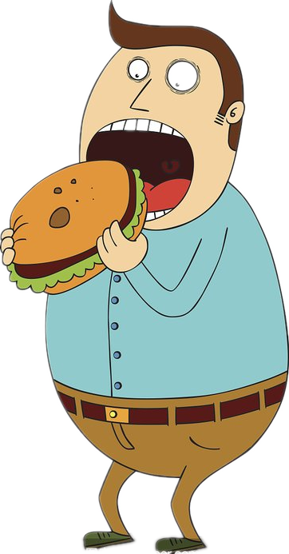
词汇积累
“进餐”词汇积累
1. 出去吃饭 eat out ; go out to dinners ; go out for dinner
2. 坐下吃饭 sit down to table ; sit at table
3. 在吃饭 at table ; at meals ; at dinner ;
4. wolf down 用来形容人吃饭速度快，吃得也多，也就是汉语常说的 “狼吞虎咽”。
还可以说 “wolf down the meal” 或 “wolf the meal down”。
E.g. I wolfed my breakfast down as fast as I could and then quickly ran to school.
我三下五除二地吃完早餐，然后飞快地向学校跑去。
5. My stomach was growling from hunger. 肚子饿得咕咕叫。
6. My stomach is making noises from hunger. 肚子饿得咕咕叫。
7. My stomach is rumbling from hunger. 肚子饿得咕咕叫。
8. He was hungry enough to eat up an elephant. 他饿的能吞下一头大象。

Slide 27
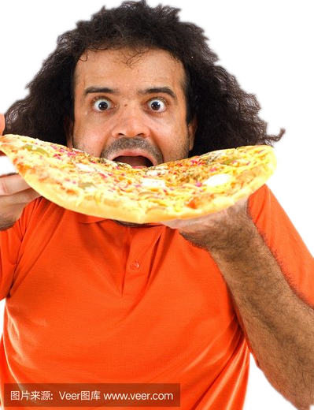
词汇积累
吃相表达
devour the food 狼吞虎咽/大口大口地吃
eat like mad 狂吃
gobble up the food 狼吞虎咽地吃
gorge oneself with food 大吃一顿
lick a saucer clean 添个干净
scoff without stop 狼吞虎咽地吃个不停
stoke oneself to belch 狼吞虎咽撑的打嗝
swallow sth. without chewing 嚼都不嚼一口吞下
guttle the food and drink 贪婪地吃着喝着
guzzle away 大吃大喝

Slide 28

词汇积累
“ glad ” 语言积累
1. have the time of one's life 度过愉快的经历，异常高兴
Eg. My friends and I had the time of our lives in Disneyland.
我的朋友们和我在迪士尼乐园玩得很开心。
2. be full of the joys of spring
Eg. He bounced into the office, full of the joys of spring.
他兴高采烈地蹦跳着进了办公室。
3. Delight took possession of her.
4. He looked at me, jumping and dancing.
相关短语：
on/at the top of the world 非常幸福、心满意足
over the moon 欣喜若狂
be walking/floating on air 欣喜若狂

Slide 29


As long as everyone gives a little love, the world will become a beautiful spring.

Slide 30
possible version 2
When I was about to say goodbye, the girl asked if I’d had lunch. I told her I hadn’t had lunch because I’d been waiting here for help for nearly three hours. The girl said they didn’t have lunch either. She suggested to her parents that we have lunch together. Their truck happened to have some food and some things for the picnic. So we ate together in a vacant lot by the side of the road. During that time, I told about what had happened to me and how I felt. They shared interesting stories about their lives in Mexico and on fruit farms. After lunch, the girl’s mother put a paper bag of fruit in my jeep. I showed my gratitude again and we said goodbye to each other.
After they left, I got into my jeep and opened the paper bag. There are some delicate fruits in the paper bag. I was surprised to find the money I had quietly left them. At the same time, there was a note written by a girl, which read “We are very happy to be able to help you. We have encountered many difficulties and been disappointed. But we met a lot of helpful people, which made us feel very warm. To help others with one’s own ability is also a kind of lifting a finger. The beauty of life comes from these lifting a finger. I hope you have a good life and a happy mood.” This made me very moved, and I would try my best to help more people in the future to make our world more beautiful and warmer.
Word: 246

Slide 31
附：原文后续
After I said my goodbyes and started walking back to the Jeep, the girl called out and asked if I’d had lunch. When I told her no, she ran up and handed me a tamale.
This family, undoubtedly poorer than just about everyone else on that stretch of highway, working on a seasonal basis where time is money, took a couple of hours out of their day to help a strange guy on the side of the road while people in tow trucks were just passing him by.
But we weren’t done yet. I thanked them again and walked back to my car and opened the foil on the tamale (I was starving by this point), and what did I find inside? My $20 bill! I whirled around and ran to the van and the guy rolled down his window. He saw the $20 in my hand and just started shaking his head no. All I could think to say was, “Por favor, por favor, por favor,” with my hands out. The guy just smiled and, with what looked like great concentration, said in English: “Today you, tomorrow me.”

Slide 32
附：原文后续
Then he rolled up his window and drove away, with his daughter waving to me from the back. I sat in my car eating the best tamale I’ve ever had, and I just started to cry. It had been a rough year; nothing seemed to break my way. This was so out of left field I just couldn’t handle it.
In the several months since then I’ve changed a couple of tires, given a few rides to gas stations and once drove 50 miles out of my way to get a girl to an airport. I won’t accept money. But every time I’m able to help, I feel as if I’m putting something in the bank.
From the tire iron and the tamale
the New York Times magazine

Slide 33
During this past year, I've had three instances of car trouble. Each time these things happened, I was sick of the way most people hadn't bothered to help. One of those times, I was on the side of the road for close to three hours with my big Jeep. I put signs in the windows, big signs that said NEED A JACK（千斤顶）, and offered money. Nothing. Right as I was about to give up, a Mexican family in a small truck pulled over, and the father bounded out.
He sized up the situation and called for his daughter, who spoke English. He conveyed through her that he had a jack but that it was too small for the Jeep, so we would need something to support it. Then he got a saw（锯子）from the truck and cut a section out of a big log on the side of the road. We rolled it over and put his jack on top, and we were in business.
I started taking the wheel off, and then, if you can believe it, I broke his tire iron. No worries: He handed it to his wife, and she was gone in a flash down the road to buy a new tire iron. She was back in 15 minutes. We finished the job, and I was a very happy man.
The two of us were dirty and sweaty. His wife prepared a pot of water for us to wash our hands. I tried to put a $20 bill in the man's hand, but he wouldn't take it, so instead I went up to the truck and gave it to his wife as quietly as I could. I asked the little girl where they lived. Mexico, she said. They were in Oregon so Mommy and Daddy could work on a fruit farm for the next few weeks. Then they would go home.

Slide 34
During this past year, I've had three instances of car trouble. Each time these things happened, I was sick of the way most people hadn't bothered to help. One of those times, I was on the side of the road for close to three hours with my big Jeep. I put signs in the windows, big signs that said NEED A JACK（千斤顶）, and offered money. Nothing. Right as I was about to give up, a Mexican family in a small truck pulled over, and the father bounded out.
He sized up the situation and called for his daughter, who spoke English. He conveyed through her that he had a jack but that it was too small for the Jeep, so we would need something to support it. Then he got a saw（锯子）from the truck and cut a section out of a big log on the side of the road. We rolled it over and put his jack on top, and we were in business.
I started taking the wheel off, and then, if you can believe it, I broke his tire iron. No worries: He handed it to his wife, and she was gone in a flash down the road to buy a new tire iron. She was back in 15 minutes. We finished the job, and I was a very happy man.
The two of us were dirty and sweaty. His wife prepared a pot of water for us to wash our hands. I tried to put a $20 bill in the man's hand, but he wouldn't take it, so instead I went up to the truck and gave it to his wife as quietly as I could. I asked the little girl where they lived. Mexico, she said. They were in Oregon so Mommy and Daddy could work on a fruit farm for the next few weeks. Then they would go home.

Slide 35
When I was about to say goodbye, the girl asked if I'd had lunch. However, with hesitation in my mind, thinking about the trouble I had brought to the family, I told her I had, feeling appreciated but actually hungry at the same time. Suddenly, my rumbling stomach betraying me, I had no choice but to admit I was starving, with an awkward smile on my face. Winking her eyes, she put her hands over her mouth and smiled.Asking me to wait for a while, she went back to her family, searching around their car, heading back towards me, with a bottle of water, a chicken roll as well as some fruit held in her hands. At that moment, the girl failing to hold so many items, her mother provided her with a small paper bag, talking to her in whispers. Then, with joy and excitement full of her heart, she ran to me, handing me the samll paper bag.When I took over the bag, she waved me good bye and wished me good luck.
After they left, I got into my Jeep and opened the paper bag. Obviously, the bag was filled with food and drinks. To my surprise, the $20 bill, which was enough to cover a budge of one month, came into sight, along with a note attached, reading “ rose presented, smell remained”. In an instant, with tears of rolling in my eyes, I was more than moved,In an instant, with tears of rolling in my eyes, I was more than moved. They would never know what they did for me meant far more than they could imagine.On the rest of my journey, the valuable experience haunting, I kept thinking about how kind and enthusiastic they were to help a stranger. I felt a strong sense of mission, for a Mexican family, total strangers, gave me a hand in time, rebuilding my faith in people and encouraging me to pass on the act of kindness to others, which, indeed, was undoubtedly not only profound but also exciting.

Slide 36

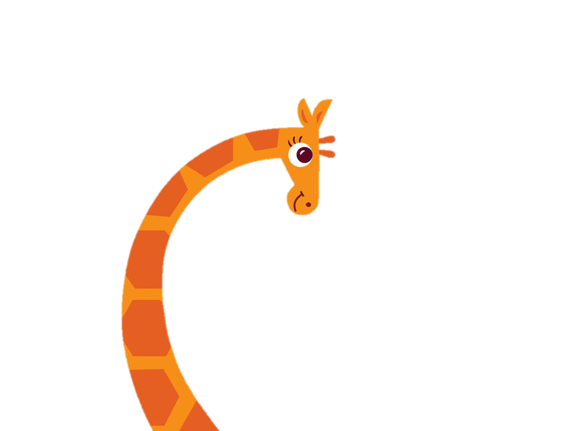
THANKS！

